Slide 1

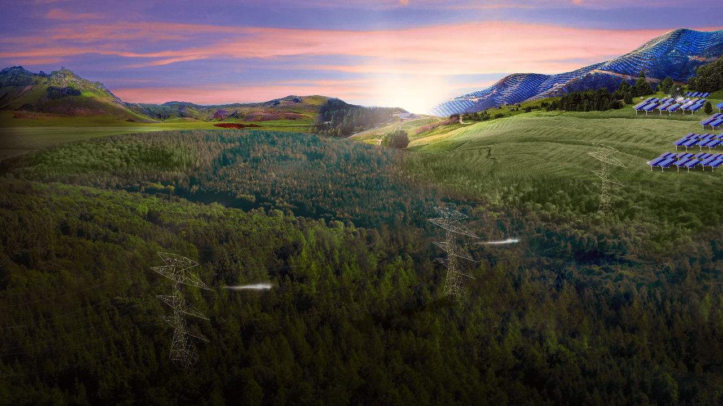


ISA: Creating
Sustainable value

Slide 2


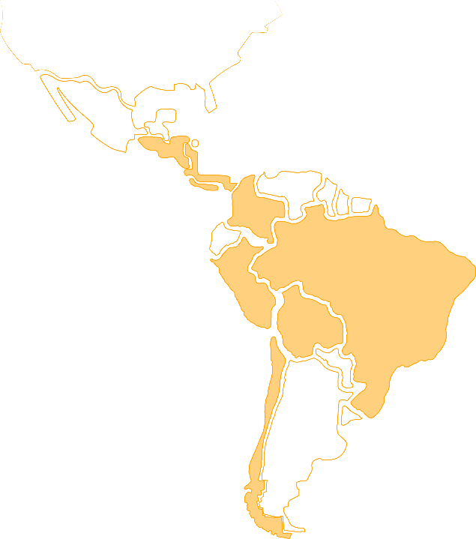



Leading Multi-Latin energy and infrastructure platform, operating strategic assets in the region
Colombia
Electric Power Transmission
Market Share:
Toll Roads Concessions
Ruta Costera:
64%
146 kms
Peru
Brazil
Colombia
Electric Power Transmission
Market Share:
Electric Power Transmission
Market Share:
73%
19%
Peru
Chile
Brasil
Electric Power Transmission
Market Share:
Toll Roads Concessions
Intervial:
Bolivia
13%
714 kms
Key Financial Metrics
104.438 MVA
48.766 / 99,8%
Line circuit kms / Reliability
Chile
860 / 137 kms
Operation / Construction
57.455 kms
Fiber optic
In operation
Argentina

Slide 3






ISA, 55 years in Colombia & Latin America
2002
Second equity issuance: 47.000 new shareholders
2021
Ecopetrol acquires ISA and aims to become one of the most important energy conglomerates in the world
1967
Establishment of ISA
1982-1984
Chivor and San Carlos I Hydroelectric power plants went into operations
1998
Inception of TRANSELCA, ISA’s first electricity transmission subsidiary in Colombia
2006
Acquisition of CTEEP, marks ISA's entry to the Brazilian energy business
2012
Creation of INTERCHILE
1994
Law 142- 143 Spin-off of generation assets to establish ISAGEN
2003
Entrance into Bolivia with ISA Bolivia
2013
Establishment of Intercolombia, for spin-off
of electricity transmission activities in Colombia
1977
ISA enters the electricity generation business, with the construction of hydroelectric plant Chivor
2000
Initial public offering: 62.000 new shareholders
2009
ISA begun activities to enable binational energy integration for Colombia and Panama
2020
ISA INTERVIAL Chile acquires Ruta Costera, entering the toll road concessions business in Colombia
1995
Colombian Government acquires a majority stake in ISA
2005
Establishment of XM
2001
Entrance into Peru with ISA Peru, followed by REP and CTM; establishment of Internexa
2010
ISA enters the toll road concessions business in Chile with the acquisition of INTERVIAL Chile
2017
Acquisition of 14.8% in TAESA in Brazil

Slide 4



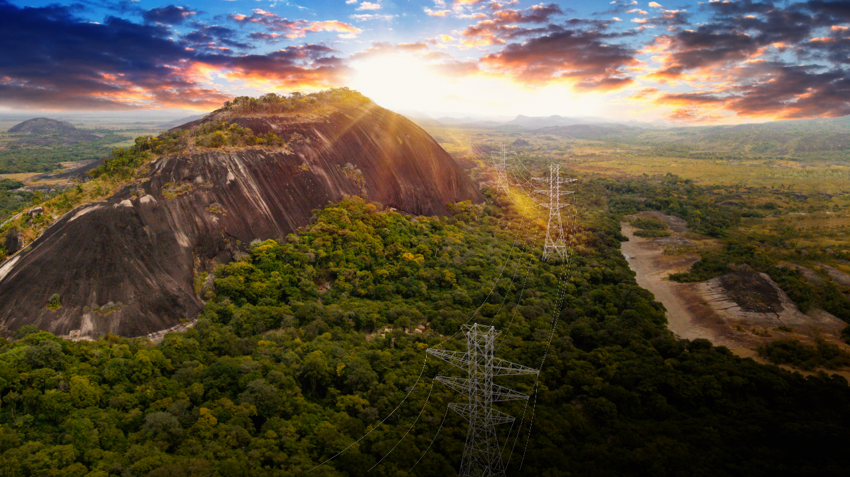












ISA and its companies
Pension Funds
Other Investors
51,4%
8,8%
27,3%
12,5%
INTERCOLOMBIA
TRANSELCA
INTERVIAL
INTERNEXA
ISA PERÚ
TRANSMANTARO
REP
RUTA DE LA ARAUCANÍA
RUTA DEL BOSQUE
RUTA DEL MAIPO
CTEEP
ISA BOLIVIA
INTERCHILE
RUTA DE LOS RIOS
RUTA DEL LOA
RUTA COSTERA

Slide 5
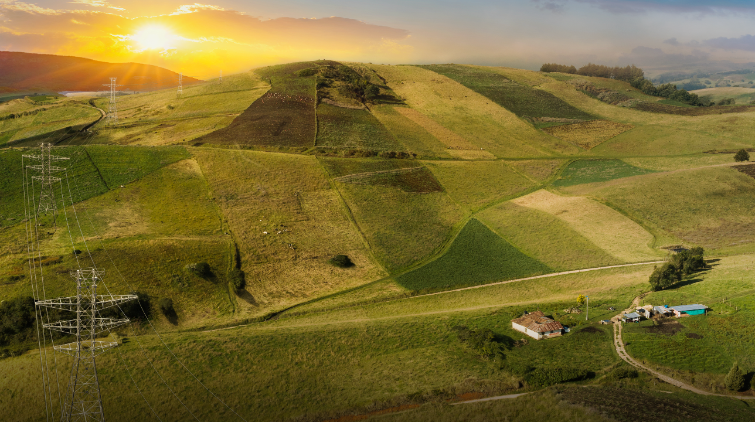






Shareholder Value: Growth generation of profitability, application of good corporate governance practices
Sustainable Value
Positive Social and Enviromental Impact: Significant contribution to caring for the planet and achieving the Sustainable Development Goals in the countries where the Group is present
Corporate Longevity
The companies of the future must leverage the generation of value with innovation, digital transformation, alliances and a group of high-performance collaborators
ISA 2030 strategy is oriented towards the creation of Sustainable Value

Slide 6



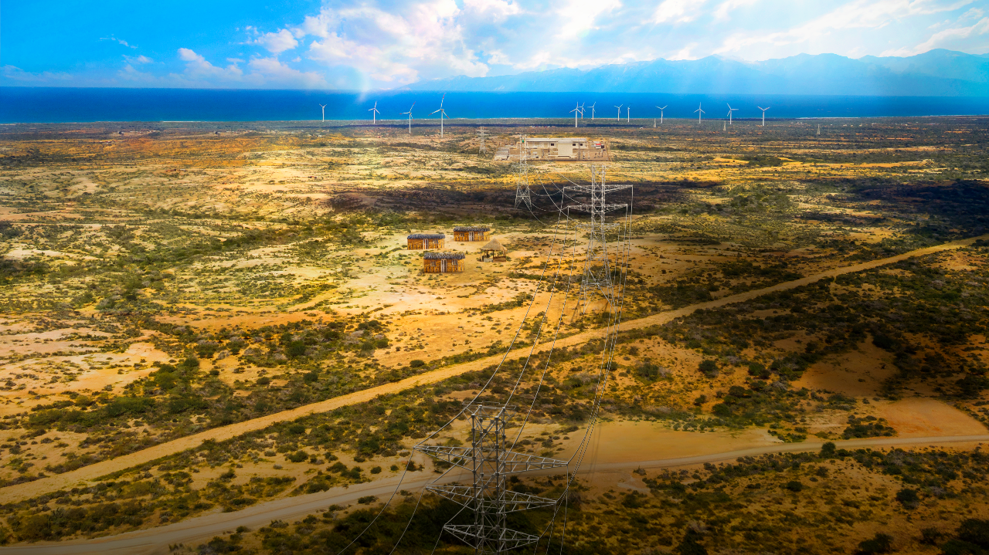
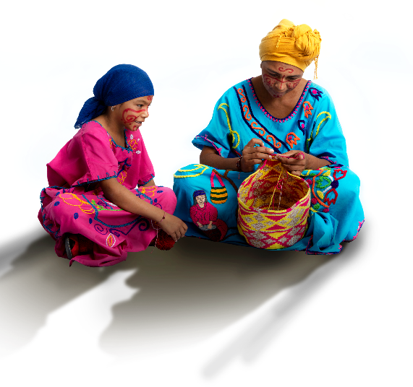
Why should you invest in ISA?
Regulated businesses with stable and predictable cash flow generation
Growth strategy
Attractive risk-return ratio due to geographic and multisectoral diversification
Growth with profitability, maintaining a healthy level of indebtedness
Attractive shareholder returns
.

Slide 7

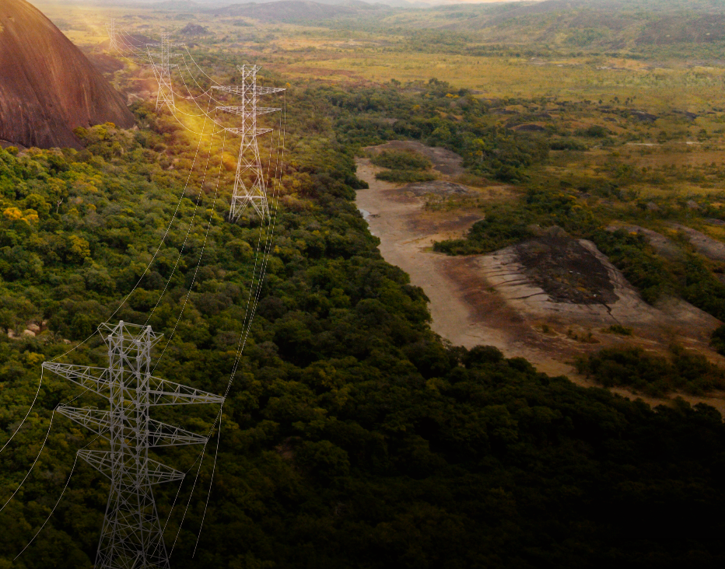








Highly regulated businesses with no demand risk, and stable and predictable cash flows
1
Regulated income paid according to availability (no demand risk)
ISA's strategy is to continue operating under regulated schemes that encourage operational efficiency.
Power Transmission
Toll Roads
Income indexed to the IPC or IPP depending on each jurisdiction.
30% consolidated income in USD.
Income subject to periodic review by the regulatory authorities of each country.
Revenues derived from toll road concessions and government payments.
Operation under the “total income scheme” guaranteed by the Government.
Traffic decreases are offset with term extensions or government payments.

Slide 8












Continuous growth ensuring shareholder value generation
Capex breakdown
2
Backlog: COP $22,4 trillion⁽¹⁾
USD 5,7 billion
Telco
Roads
2%
14%
Brazil
Others
Business
Energy
84%
⁽¹⁾ Only includes capex of affiliates in which control is exercised

Slide 9
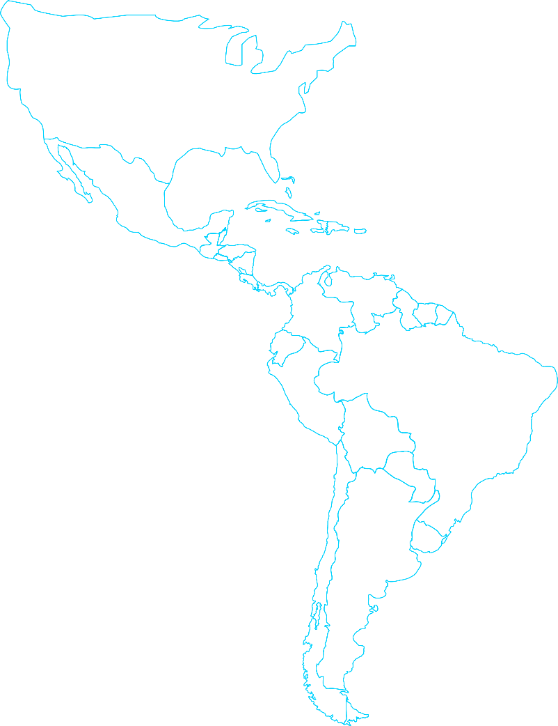











2023 Growth opportunities with a focus on profitability
Panamá
USD 0,9 bi, 4%
2
Colombia
USD 3,2 bi
15%
Electric power transmission
Brazil
USD 10,8 bi
51%
Perú
USD 1,1 bi
5%
USD 15,5 billion
New businesses
Chile
USD 5,1
24%
USD 21 billion*
Roads
USD 5,5 billion

Slide 10
3
Attractive risk-return ratio due to geographic and multisectoral diversification
EBITDA ⁽¹⁾ by Country
EBITDA ⁽¹⁾ by Business
4Q22
4Q22
Assets by Country
Assets by Business
____________________
(1) Excluding construction

Slide 11

4
Growth with profitability
Revenues
EBITDA
Figures in USD Million
CAGR
2018-2022
6,5%
Figures in USD Million
CAGR
2018-2022
5,5%
EBITDA Margin ⁽¹⁾
____________________
(1) Excluding construction

Slide 12


4
Growth with profitability
Net Income
ROE
Figures in USD Million
Net Margin
Solid results that leverage our profitable and sustainable growth strategy
* Extraordinary events in ISA CTEEP:
- Periodic tariff revisión.
- Adjustments to the RBSE defined by ANEEL.
____________________
(1) Excluding construction

Slide 13

Alternar el fondo
Debt breakdown
4Q22
4
Maintaining a healthy level of indebtedness
Total Debt 4Q22
^{USD 7 bi}
ISA Rating and Consolidated Indicator
Gross Debt/EBITDA
BBB, stable
(Apr. 2022)
Baa2, stable
(Aug. 2022)
2021 | 4,1 x
4Q22 | 4,2 x

Slide 14
Alternar el fondo
4
Debt Profile

Slide 15



Alternar el fondo
Results that translate into higher profitability for our shareholders
5
$1.742
Dividends
per share
CAGR ⁽¹⁾
2018-2022
33%
Extraordinary
Payout
Ordinary
Extraordinary
$851
^{43%}
Payout ratio⁽²⁾
$1.303
$559
^{88%}
$891
CAGR ⁽¹⁾
2018-2022
13%
Ordinary
Payout
$744
$749
^{45%}
$552
$675
2019
2020
2021
2022
2023
Ordinary dividend policy
Dividend yield ⁽³⁾
Attractive and increasing dividends
40%-50%
Net Income
8,3%
⁽¹⁾ CAGR: Compound annual growth rate
⁽²⁾ Payout= Total dividend/ net income 2022
⁽³⁾ Dividend Yield= Dividend per share / share price at closing 2022

Slide 16







Acción rentable y resiliente
Comportamiento de la acción
47,9% ISA
-15% COLCAP
2018
2019
2020
2021
2022
Notes:
En el negocio de Telecomunicaciones y TIC, destaco que InterNexa está participando con el Ministerio de Tecnologías de la Información y las Comunicaciones de Colombia, con la Consejería de Transformación Digital y otros operadores del mercado, en el modelamiento de una solución para incrementar la conectividad en diferentes regiones de Colombia. En un año de grandes desafíos en los negocios y en mercados, la compañía aumentó los niveles de satisfacción de clientes a 8,41 subiendo dos puntos con respecto al año anterior.
Creo importante mencionar que, sobre el anuncio realizado el año anterior acerca del proyecto de venta del 100 % de las acciones que ISA tiene en InterNexa, el gobierno ha manifestado su interés en evaluar otras opciones estratégicas diferentes; es así como la Junta Directiva de ISA decidió continuar con el negocio de telecomunicaciones dentro del portafolio de inversiones, buscando siempre opciones para incrementar su generación de valor.

Slide 17


High ESG standards
5

Slide 18





5
Sustainability management model
Environment
Social
Climate change strategy
Biodiversity
Circular economy
Sustainable finance
Social management model
Promote the creation of long-term alliances, strengthening relationships with communities, while mitigating risks and impacts.
Link between human talent and sustainable practices.
Occupational health and safety actions, “Conectados con la vida” program
Sustainability
A way of being
Governance
Ethical and integrity culture
Independent and diversified management structure
Transparency and accountability
Regional Programs

Slide 19






5
Ethical culture and integrity
Organizational culture, ethics is in the DNA
Ethics and compliance business program
Human rights
Independence and diversity in the management bodies
Board Composition and Committees that support the Board
Gender Diversity
Governance
4 axes
Administration with managerial criteria
Strategy focused on generating sustainable value
Guide management and decision making
Strong risk management system
Procedures for managing conflicts of interest
Work model of ISA and its companies aimed at value generation
Transparency and accountability
Accurate, complete and timely information to stakeholders
High standards for reporting financial and non-financial information
Interaction with interest groups
Respect for the rights of shareholders and investors

Slide 20








ESG ACHIEVEMENTS
11 companies
5 countries
3 business units
Economic reactivation investment
Alas 20 Colombia company
2nd place - sustainable company
  Carbon
  Neutrality
COP 3.670 million
+ 287 thousand people
Member of
Dow Jones Sustainability Indices
Powered by S&P Global CSA
+2 points in DJSI
Beneficiaries of social programs
  Emission reduction
  through eco-efficiency
  practices
+6.700 CO₂ Ton
Social performance
5th company in the industry DJSI
Top 10% S&P Global ESG Score
  Offset emissions
+41.000 CO₂ Ton
5
FTSE4Good
ISA affirmed
ISA CTEEP entry
Enviromental investment 2022
COP 188 billion
Social Investment 2022
+ COP 35 billion
Sector Best company
ISA CTEEP,
A- rating⁽²⁾
SROI⁽¹⁾
2,4X
⁽¹⁾ SROI (Social return on investment): It is a measurement of social program impacts to society.
⁽²⁾ CDP: It assesses the risks and opportunities related to the environmental impacts of more than 20,000 companies around the world.

Slide 21




Reemplazar foto por el KV final enviado por mail el Domingo 19.

